Slide 1
Quel chien préfères-tu? Which dog do you prefer?

Slide 2
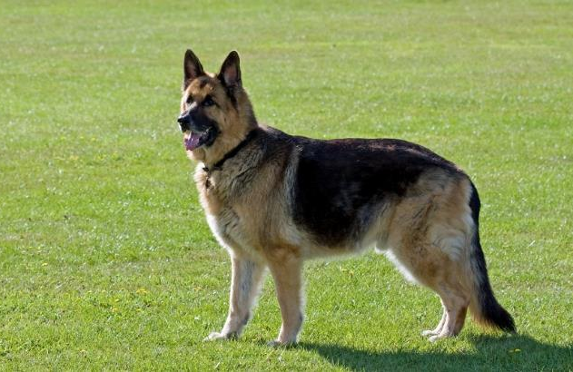
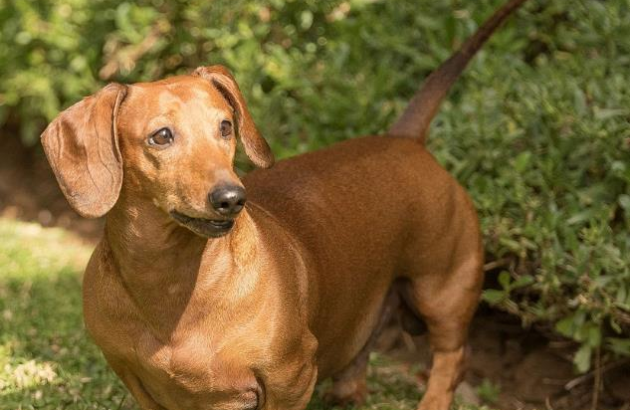
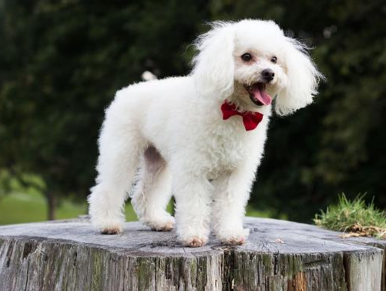
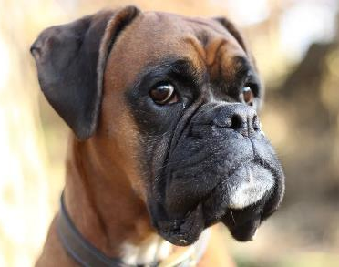
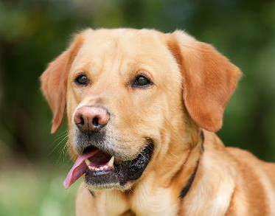

Slide 3
Je pense que (I think that) | le berger allemand (the Alsatian) le boxer le teckel (the dachshund) le caniche (the poodle) le labrador | est | plus beau que (more beautiful than) plus intelligent que (more intelligent than) plus méchant que (more vicious than) moins beau que (less beautiful than) moins intelligent que (less intelligent than) moins méchant que (less vicious than) | le berger allemand (the Alsatian) le boxer le teckel (the dachshund) le caniche (the poodle) le labrador

Slide 4
Je p….. que (I think that) | le berger all……… (the Alsatian) le b……. le t……. (the dachshund) le ca…….. (the poodle) le la……… | est | plus b….. que (more beautiful than) plus i……………… que (more intelligent than) …… méchant ….. (more vicious than) moins b…… que (less beautiful than) ……… intelligent ….. (less intelligent than) ……… m…………. que (less vicious than) | le berger a………….. (the Alsatian) le b….... le t…….. (the dachshund) le c………. (the poodle) le l……….

Slide 5
Je pense que (I think that) | le berger allemand (the Alsatian) le boxer le teckel (the dachshund) le caniche (the poodle) le labrador | est | le plus beau (the most beautiful) le plus intelligent (the most intelligent) le plus méchant (the most vicious) le moins beau (the least beautiful) le moins intelligent (the least intelligent) le moins méchant (the least vicious)

Slide 6
Guessing game
Partner A writes down a sentence practised so far
Partner B has to guess
Take turns

Slide 7
Complétez les phrases
Je pense que le caniche est plus b___ que le labrador
Je pense que le berger allemand est p___ in_______ que le b____
Je pense que le Labrador est p___ méchant ___ le caniche
Je pense que le teckel est p___ b___ ___ le ca______
Je pense que le berger all______ est moins in______ q__ le teckel
Je pense que labrador est m____ méchant ___ le teckel
Je pense que le ca_____ est m____ b___ ___ le la______
Je _____ ___ le t____ ___ m____ i________ ___ le b____ a_____

Slide 8
Make up some of your own using these words
labrador teckel berger allemand caniche
gros (big) mignon (cute) dangereux (dangerous)
bête (stupid) rapide (fast)
Exemple: Je pense que le caniche est plus mignon que le boxer

Slide 9
Rank order by its qualities – votez!
beau | intelligent | gros | rapide | méchant

Slide 10
Teacher’s notes
You could spend some time on the sentence builder doing choral reading aloud, paired reading aloud, “guess my sentence”, instant translation both ways, etc
Make sure pronunciation is solid before moving on.
Slide 8 could be done with a class vote after each pupil has filled in their own grid (which they can draw)

